Slide 1
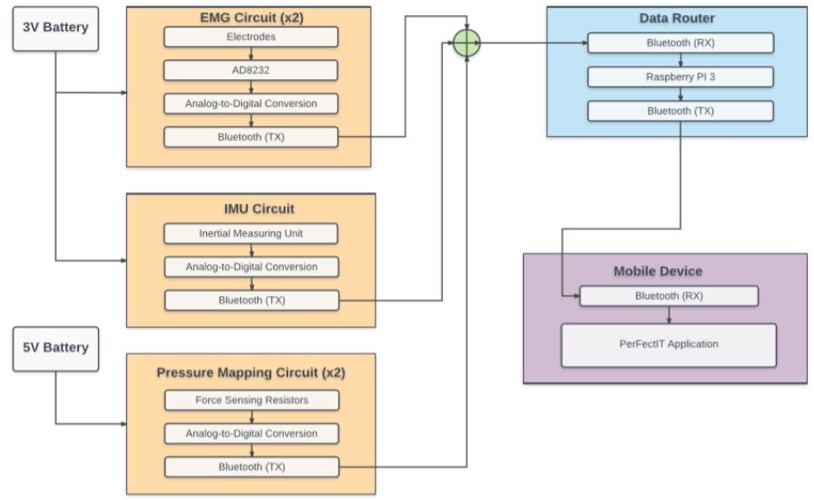
PerFectIT
Andrew Sjogren, Maxwell Gerhardson, Sai Yarram, Nick Raymond
Faculty Advisor: Prof. Yeon Sik Noh
Abstract
System Overview
PerFectIT is a real time fitness monitor that will allow people to observe and correct their fitness progress. This system will provide feedback to the user, allowing them to correct their form in real time, helping decrease injuries caused by repetitive incorrect motion. People ranging from beginners to gym experts can benefit from this device because it provides a quantitative form of feedback that is unlike fitness methods that exist today. PerFectIT incorporates 3 groups of sensors, these sensors will then transmit the data real time to an Android device, which allows for full body analysis of any exercise
HW Block Diagram
Results
Specifications
Acknowledgement
Department of Electrical and Computer Engineering
ECE 415/ECE 416 – SENIOR DESIGN PROJECT 2018
College of Engineering - University of Massachusetts Amherst
SDP18

Slide 2
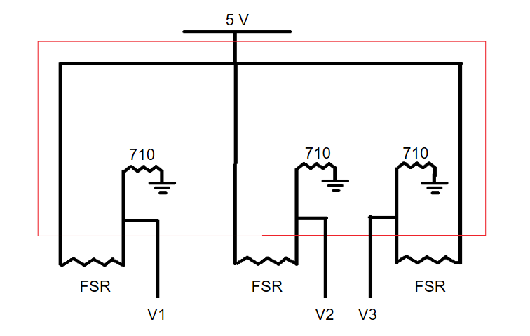
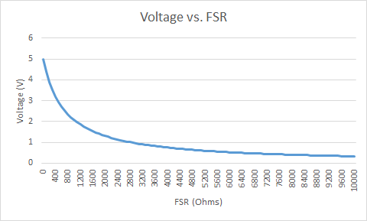
SW Block Diagram
Foot Sensors
Android App
Knee Brace
Experiment
Cost
Development
Production
Part | Price
PCB | 33
Motor | 60
Transistor | 2
Total | 101
Part | Price
PCB | 5
Motor | 20
Transistor | 5
Total | 30

